Slide 1
Universal Design:
Accessibility and Diversity at Roskilde Festival

Slide 2
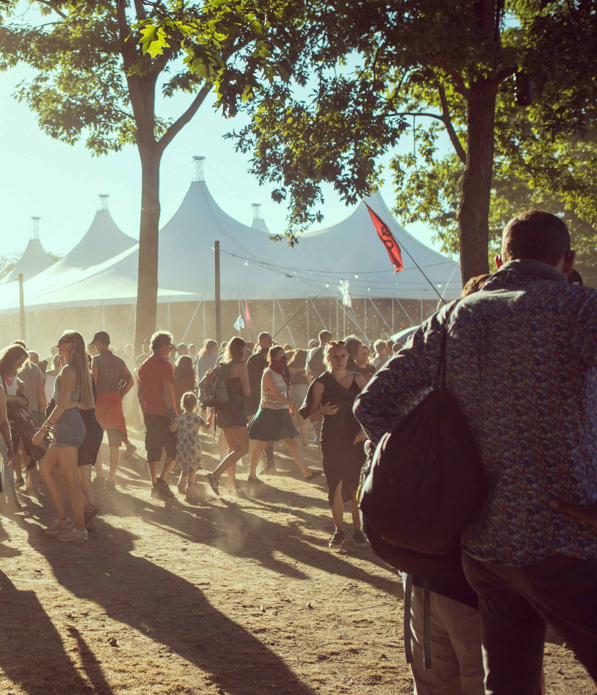
Roskilde Festival
Non-profit association
Based on volunteers
  ≈ 1,000 all year
  ≈ 30,000 in total
Temporary city with 130,000 inhabitants
Sustainability
Multi-year planning

Slide 3
About me and
Roskilde Festival
1980: MSc, electrical engineering
1990: PhD, computer science
1994: Volunteer at Roskilde Festival
2013: Employee at RF, part time
2017: Engaged in Team Handicap Service
Jeg er nybegynder hvad angår Universelt Design

Slide 4




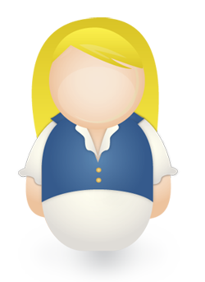

17%
Of the Danish population
(16-64 years) have a disability

Slide 5











Disabilities are diverse...

Slide 6
Roskilde Festival for young people with disabilities
A coming-of-age ritual to join the festival with your friends
Many manage with help from friends
Many stay away

Slide 7
Accessibility and Roskilde Festival
Strategies,views on disability and diversity
Technical details of toilet-facilities and ramps
Covers every team, every location
Disabilities:
Sensory
Cognitive
Physical
Psychological
…

Slide 8
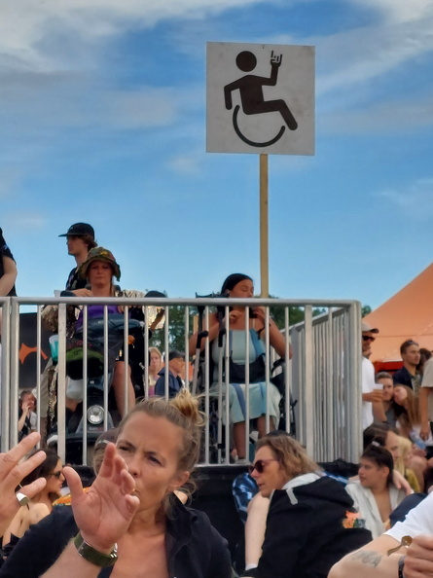
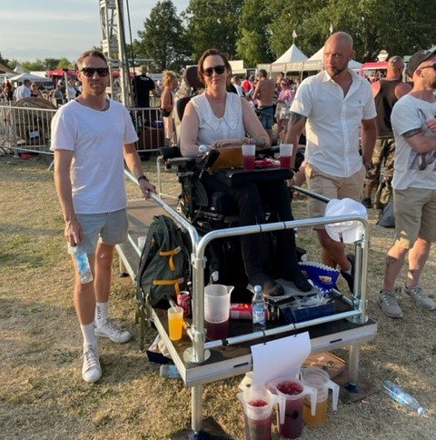
Example: Platforms
Placement, number
Design
Controlling Access
Notes:
Design: looks, platform area + height,

Slide 9
”Handicap Service”
Organizer must satisfy my needs
Organizer should do much more
I don’t want to ask for help
People with disabilitites put extra burdons on the community
Specific group, common needs
Unreasonable demands
Notes:
DTU-historien – handicappede som særlig gruppe

Slide 10
Focus on encounters: binding community
Common responsibility to take care of each other
Participate and Contribute
OK to ask for help when needed
People with disabilities are as different as everybody else
Most people have some disability some time
Be flexible and creative
Don’t be too shy to ask
Notes:
Problem with 32-hours volunteers: rules are easier than flexibility

Slide 11




4 aspects of accessibility
Physical | Psychological | Organizational | Social
Step free access Transport Toilets Lighting Surface | Good, early, accessible, sufficient information Wayfinding Feeling safe Places to relax | Flexibility Helpers, personal assistance Rules of access Economy | Openness, inclusiveness Mutual acceptance, curiosity Avoiding prejudice Strength lies in differences

Slide 12
Some challenges
Complex organization, mostly 32-hour volunteers
Strict rules are easier to handle than flexibility, good conduct
Large, diverse area
Common beliefs
  Accessibility = toilets and platforms
  Someone else takes care of the accessibility
  Only relevant for very few

Slide 13
