Slide 1
Neurodiversity and inclusivity in socio-technical systems
Valeria Borsotti, PhD Fellow - Computer Science Dept. UCPH, March 18 2023

Slide 2
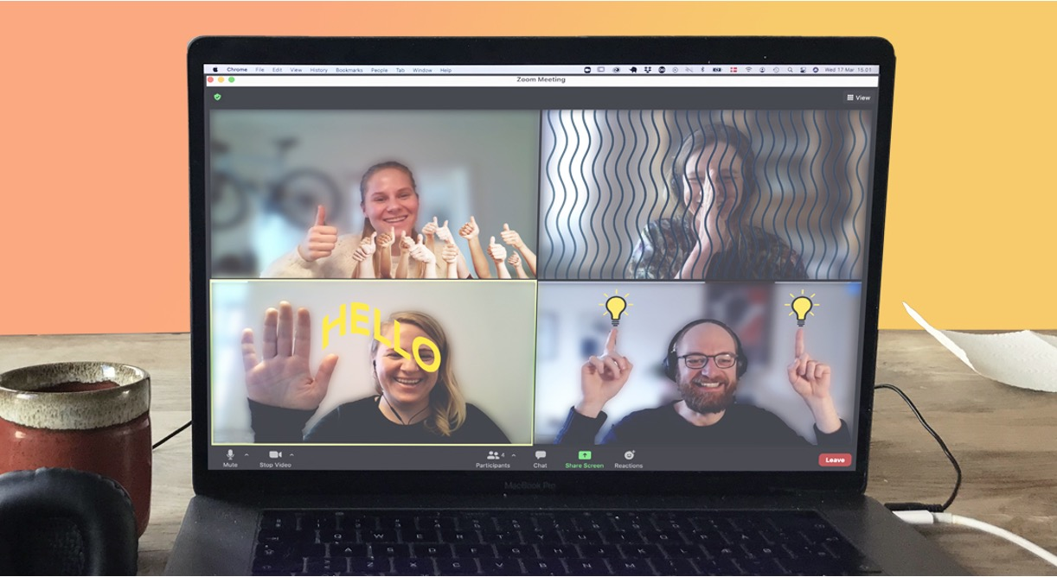
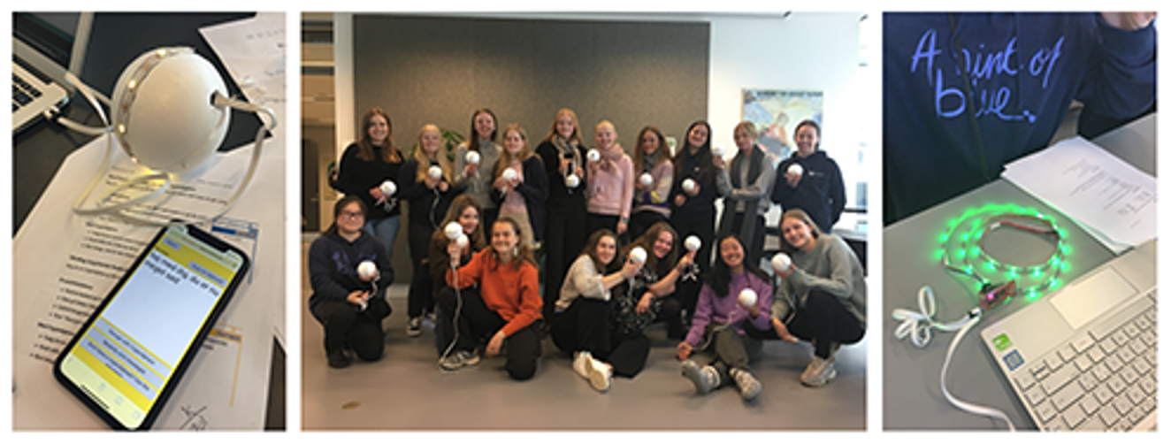

Slide 3
HOW VALUES AND NORMS ABOUT
DISABILITY AND GENDER
SHAPE DIGITAL AND PHYSICAL SPACES
IN COMPUTER SCIENCE EDUCATION
Ethnographic methods + Interventions
I study my own department!

Slide 4
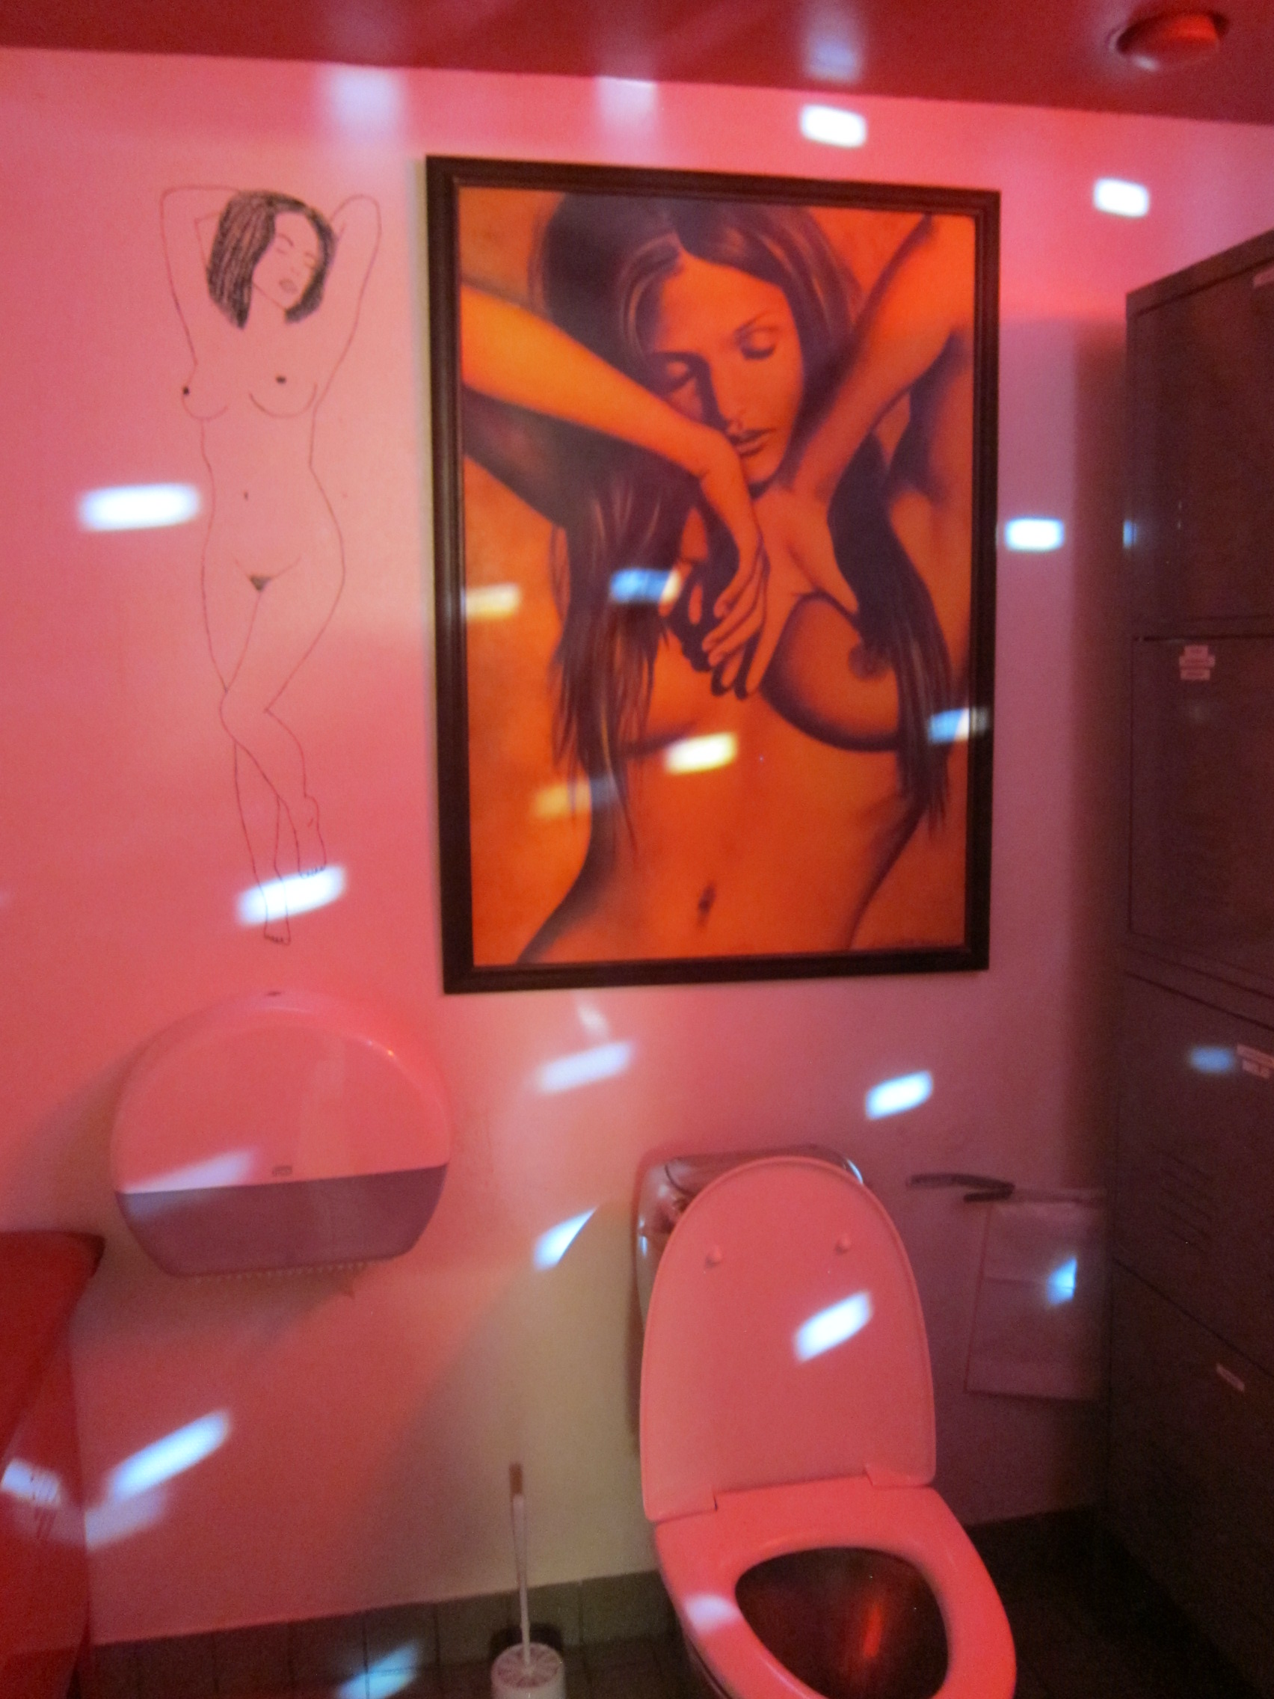
Humor and Stereotypes in Computing: An Equity-focused Approach to Institutional Accountability
Borsotti, Valeria & Bjorn, Pernille, 2022, In: Computer Supported Cooperative Work: CSCW: An International Journal. ,0, p. 771–803
DOREEN: A Game of Provocations Creating New Ambitions for Equity in Computing through Intertextual Design
Vej, J., Borsotti, Valeria, Savage, Valkyrie Arline, Engell-Nørregård, M. P. & Bjorn, Pernille, 2022, Proceedings of the 12th Nordic Conference on Human-Computer Interaction. Association for Computing Machinery, p. 1-8

Slide 5
OPEN ACCESS

Slide 6
NEURODIVERSITY IN COMPUTER SCIENCE
Neurodiversity is the diversity of human minds, the infinite variation in neurocognitive functioning within our species. (Walker, 2014)
Neurotypicals and neurodivergent
It’s Neurodiversity Celebration Week! 13th – 19th March 2023
Notes:
BRAINS but actually ”neuro” refers to the nervous system. From the 13th - 19th March, people all over the UK are encouraged to think about neurodiversity and challenge stereotypes they might have about it.

Slide 7
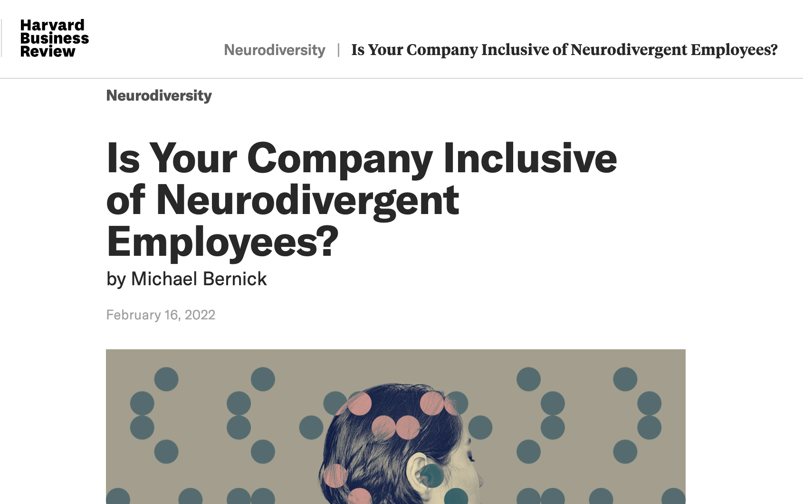
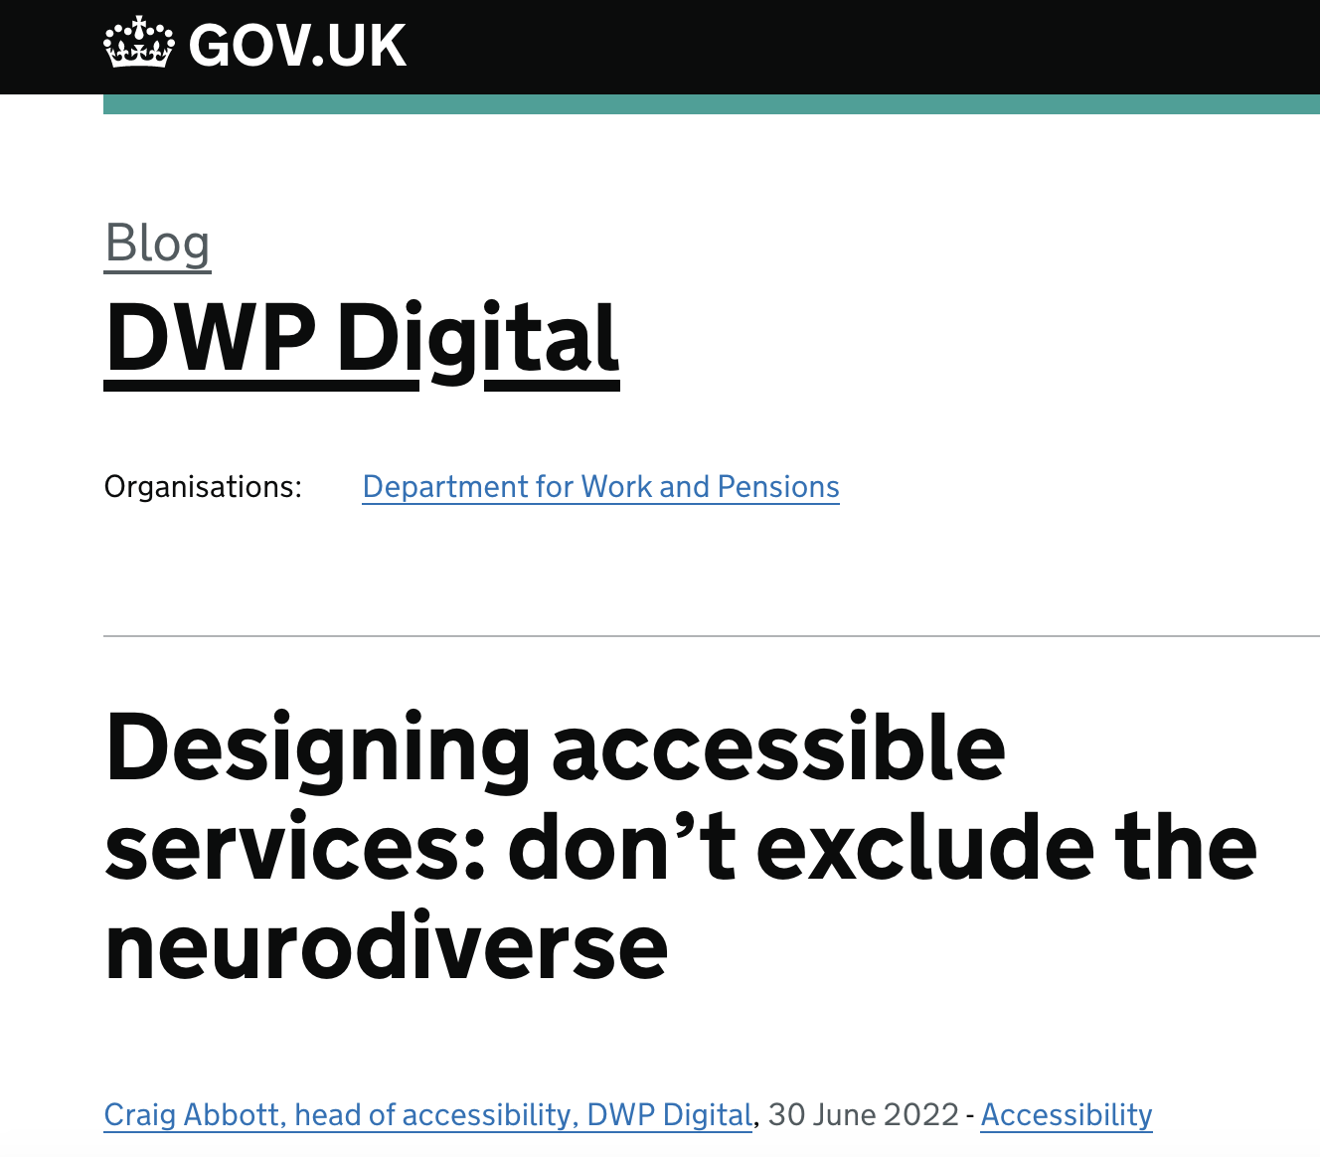
Notes:
Some of WCAG accessibility guidelines (helpful for neurodivergent users)
4.7 Low or No Background Audio: helps people who have auditory processing or focus issues.
2.4 Interruptions: helps people who get distracted easily.
3.3 Animation from Interactions: helps people who have vestibular disorders leading to headaches and nausea.
4.8 Location: helps people with a short attention span or memory issues.
1.3 Unusual Words, 3.1.4 Abbreviations, 3.1.5 Reading Level and 3.1.6 Pronunciation: help people who may struggle to read or understand written text.

Slide 8
NEURODIVERSITY
Executive function differences (working memory, skills related to planning, initiating and following through actions, inhibition, self-motivation, and focus)
Sensory sensitivity differences (hypersensitivity or hyposensitivity around touch, smell, taste, sound, sight, proprioception (body awareness), balance)
Information processing differences (assistive technology)
Fluctuations in energy + fatigue
STRESS (also due to interacting with systems not designed around neurodiversity)
PHYSICAL…Fibromyalgia, brain injury…
Notes:
While neurotypical people also display a range of strengths and weaknesses in these areas, neurodivergent individuals show more significant variation.

Slide 9
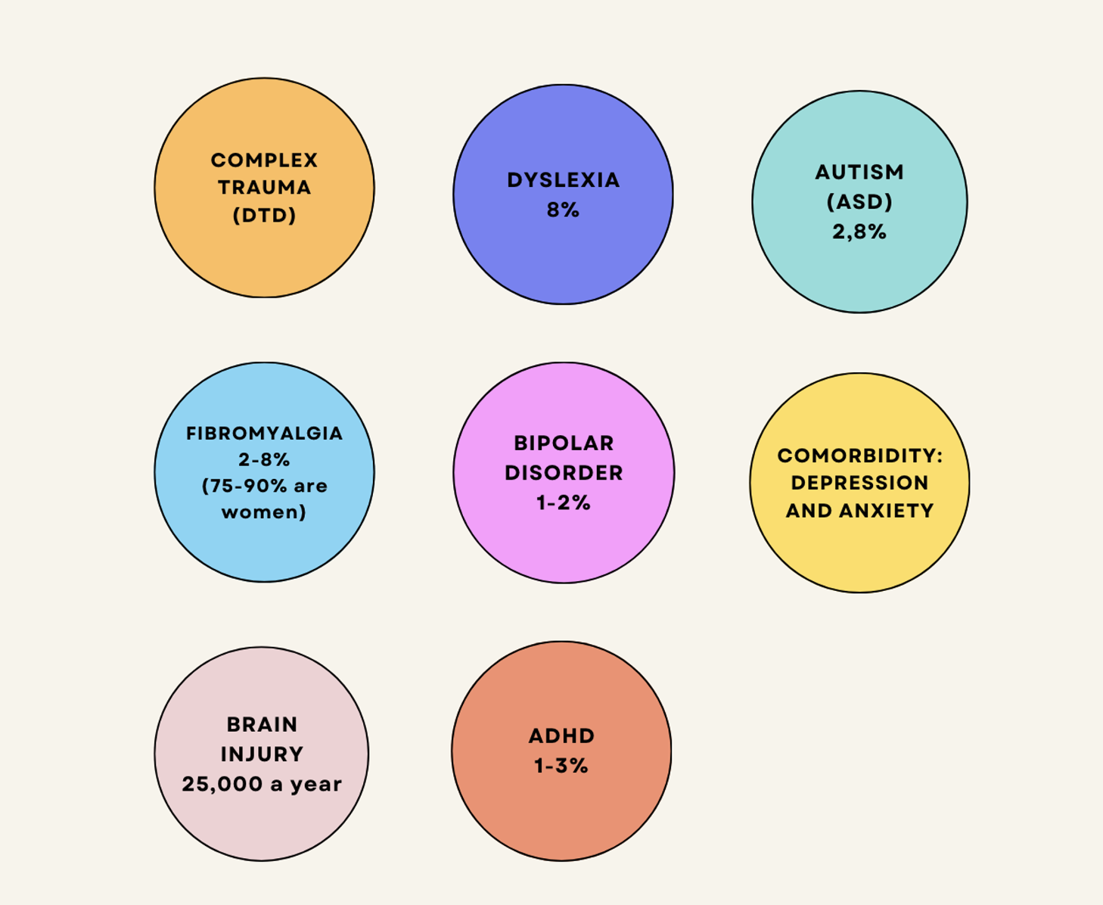
Study participants: 18 CS students
9 women – 9 men (3 Departments in Denmark)

Slide 10
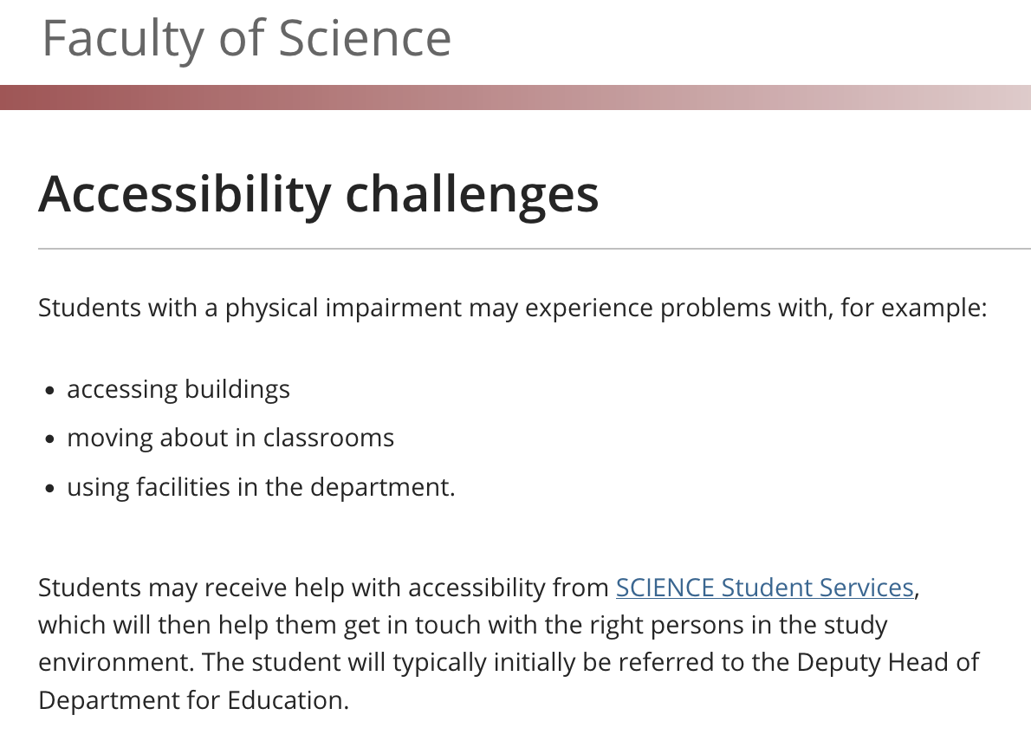
No strategic focus on inclusivity and accessibility
Notes:
Motor impairment only! Let’s design around our users

Slide 11
Notes:
Students can apply for “special support” if they have a diagnosis (accommodations like support teachers, mentors, extra time at exams and assistive tech)

Slide 12
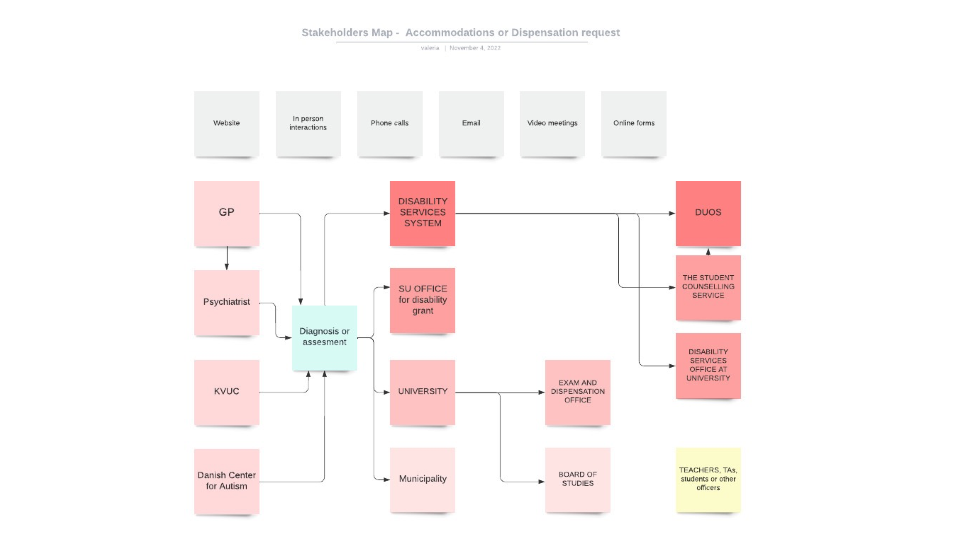
Notes:
Students with multiple diagnosis go via different systems multiple times

Slide 13
BARRIERS – preliminary findings
Teachers are unaware of the access needs of students!
No inclusivity guidelines in social events
Digital: poor Information Architecture, no Usability testing, no Accessibility testing
Physical spaces do not take sensory needs + needs related to AT into account
Navigating bureaucracy requires effort and time
STRESS (also due to interacting with systems not designed around neurodiversity)
STIGMA and discrimination due to lack of literacy and training around disability

Slide 14
“Every time I go to an exam, I have to apply for getting this dictionary. And I only got them to approve it once in 3 years of my bachelor (…) it’s because the Board of studies think I will cheat.”
(woman, dyslexia)
- LACK OF LITERACY AROUND DISABILITY
- REPEATED BUREACRATIC TASKS
Notes:
Lack of literacy + too much effort in applying for the same tasks (and then getting denied)

Slide 15
“They wanted me to have these meetings all the time, which, with an autism spectrum disorder in particular, if I'm a bit stressed out because of other things, then that's actually extremely stressful.”
(man, autism and ADHD)
- REPEATED BUREACRATIC TASKS
Notes:
Lack of literacy + too much effort in applying for the same tasks (and then getting denied)

Slide 16
“As a person with ADHD (…) computer science is insanely detail oriented and (…) you just tune out, and suddenly half the lecture will not make sense (…) Danish is not my first language, so in some of the lectures I did not understand the words (…) but I can just keep pausing [a video lecture] and replaying until I get it”
(man, ADHD)
- REMOTE ACCESS IS HELPFUL BUT UNEVEN
Notes:
Lack of literacy + too much effort in applying for the same tasks (and then getting denied)

Slide 17
“I have my little scripts, my little manuals for what is normal human interaction. And I follow those to avoid getting in trouble and getting more easily spotted as neurodivergent.
So I can fake it (…) I am acting all the time. But it takes energy (…) I’ve practiced so much that a lot of people are like whoa, you don’t seem autistic at all. And I am like, well, what does autism look like exactly? Do you expect me to be like Rain Man? Or what is your picture of autism? ”
(woman, autism)
STEREOTYPES
Notes:
Lack of literacy + too much effort in applying for the same tasks (and then getting denied)

Slide 18
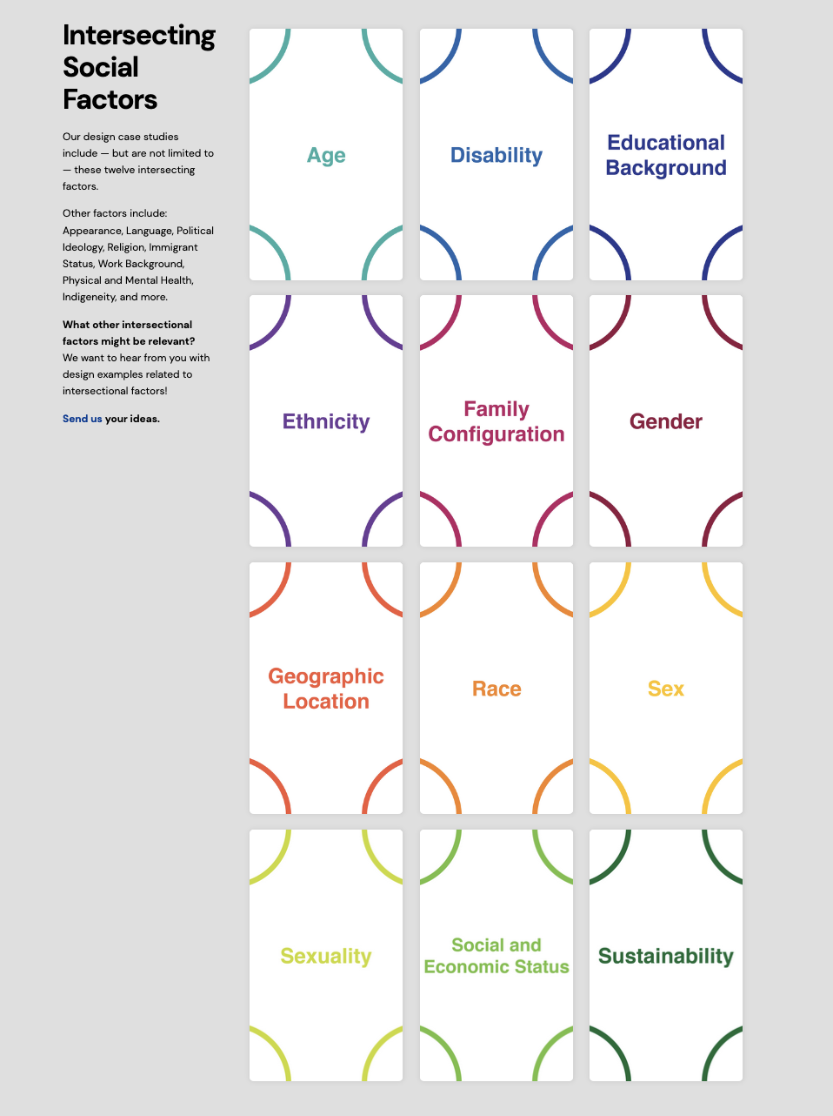
My research has an intersectional approach:
Mental health, gender, immigrant status, sexual orientation, ethnicity - and more - shape how neurodivergent individuals interact with socio-technical systems, intensifying some of the barriers
A great resource for design: https://intersectionaldesign.com/
Notes:
WHEN DESIGN SERVICES - Please always have an intersectional approach ☺

Slide 19
NEURODIVERSITY
Some good practices…get to know your service users!
Multimodal systems and ways of interacting! (multiple options + flexibility)
Universal Design for Learning (UDL)
Provide integration for assistive technology
Avoid stereotyped narratives and deficit narratives
For events: very clear instructions, timing, built-in breaks, opportunity for quiet rooms, consider the sensory environment
Engage with advocacy groups and their resources and guidelines!

