Slide 1
Bevica Scholarship Pecha Kucha
Musholm, Korsør
11 February 2023
Pride & Pinkwashing
Jannick Friis Christensen, PhD
Postdoctoral Researcher
Department of Business Humanities and Law
+45 3151 6485 | jfc.bhl@cbs.dk

Slide 2
One of the worst companies in the world…

Slide 3
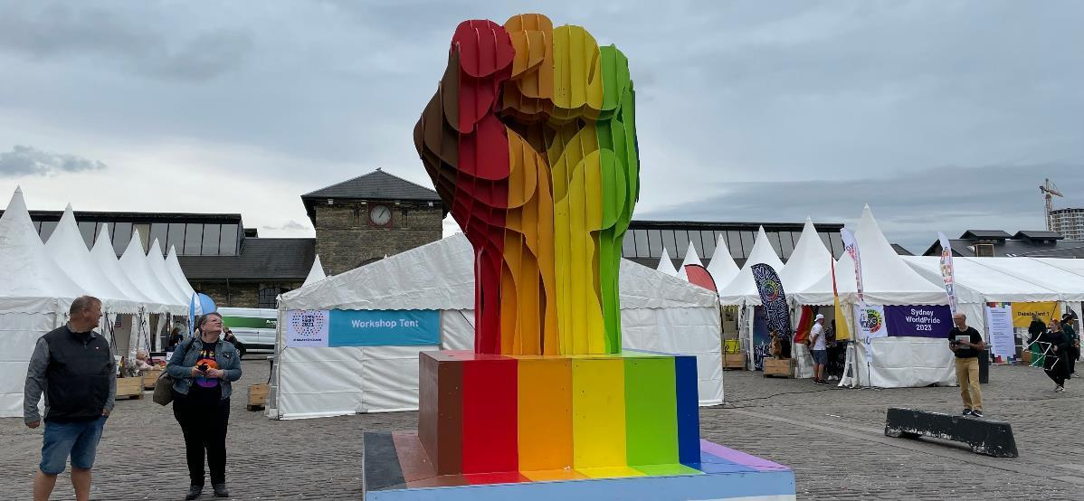
From fringe fight…

Slide 4
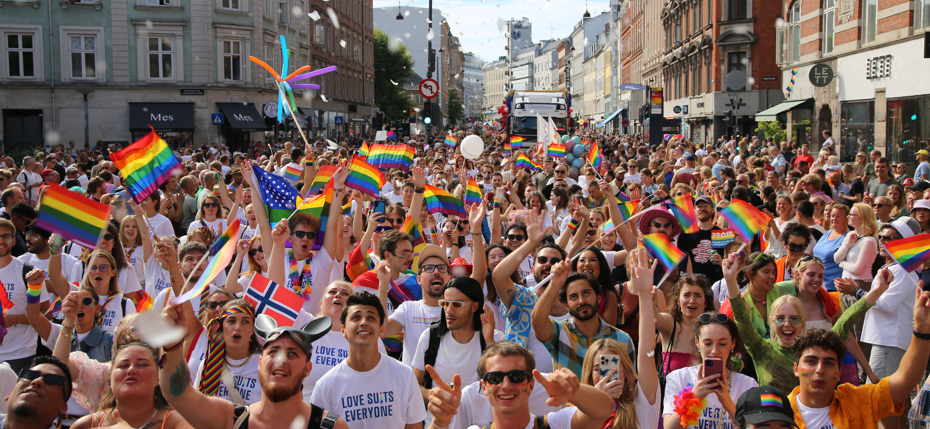
…to mainstream

Slide 5
What pinkwashing is not

Slide 6
Fraudulent breast cancer cause marketing

Slide 7
Israel as gay safe haven in Middle East

Slide 8
Homonationalism

Slide 9
Symbolic support

Slide 10
Organised hypocrisy

Slide 11
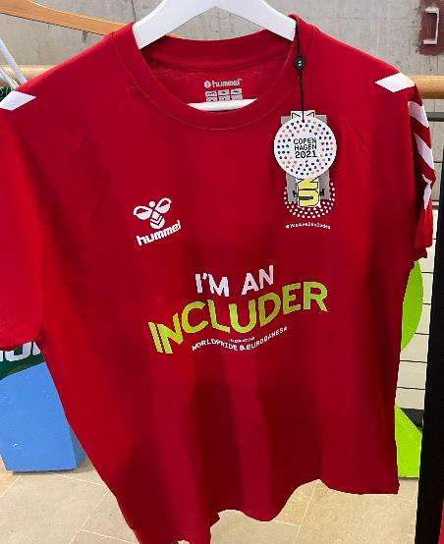
Profiting without giving back

Slide 12
‘Disconnective action’

Slide 13
Doing well but not doing good?

Slide 14
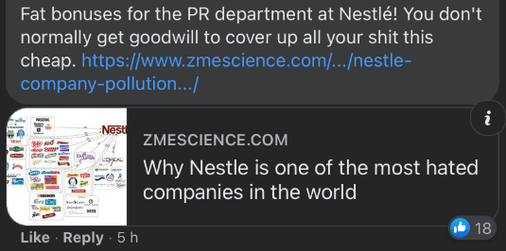
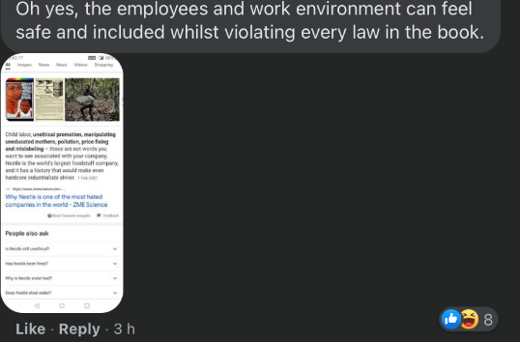
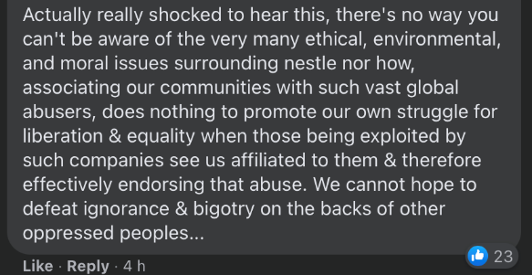

Slide 15
Solidarity across differences

Slide 16
Greenwashing…

Slide 17
…or green-hushing

Slide 18
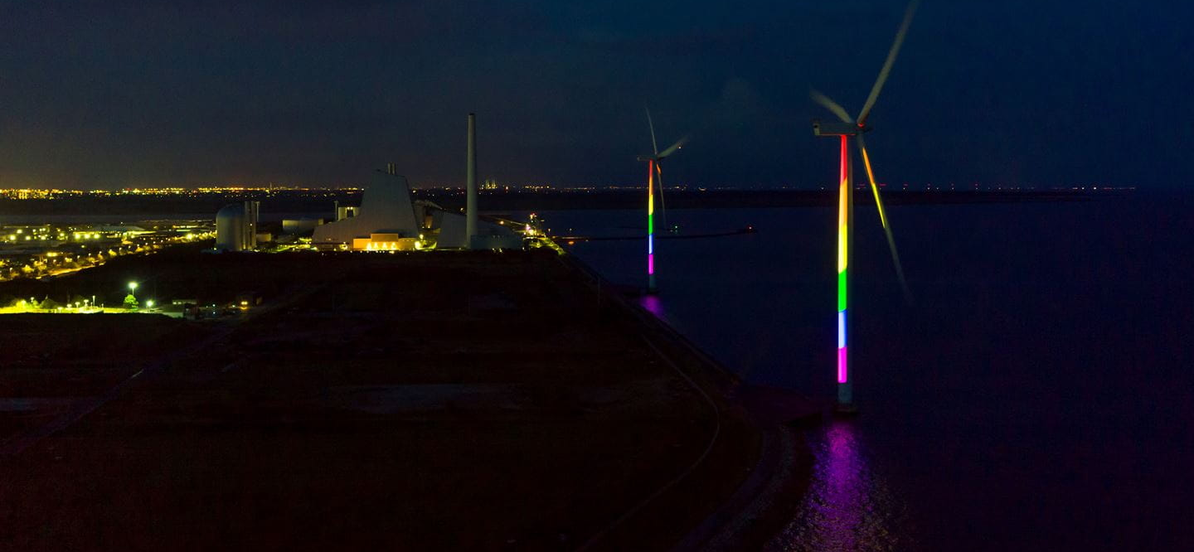
What’s sustainable?

Slide 19
What constitutes ‘washing’…

Slide 20
…in relation to accessibility, universal design

