Slide 1
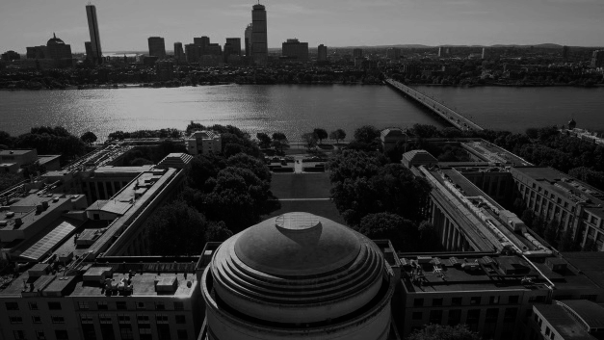
MAKING HERETICS OUR HEROES
-
Lars Frolund, PhD
Notes:
Slide on Program Creation, APM,

Slide 2
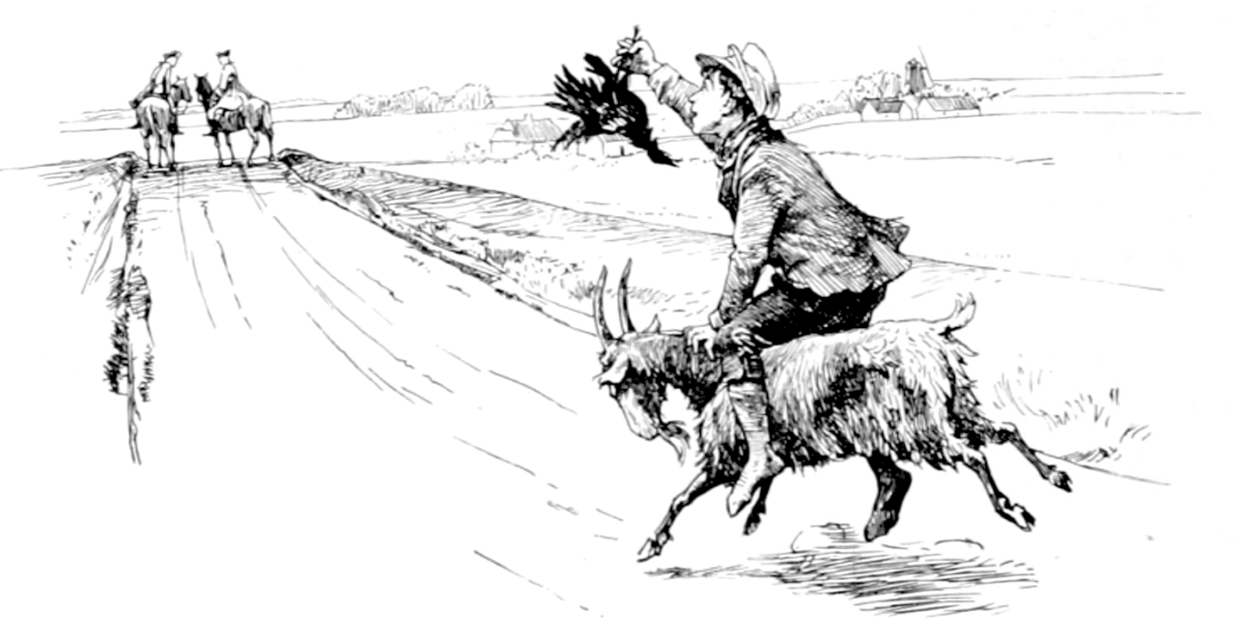
JACK THE DULLARD PRINCIPLE
Notes:
What is missing in the picture?

Slide 3
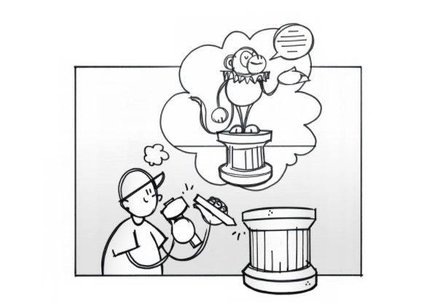
THE MONKEY READING SHAKESPEARE PRINCIPLE
If you were to put a monkey on a pedestal reading Shakespeare, how would you go about it?

Slide 4
Thank you
Dr. Lars Frolund
Frolund@mit.edu
Notes:
Slide on Program Creation, APM,

