Slide 1
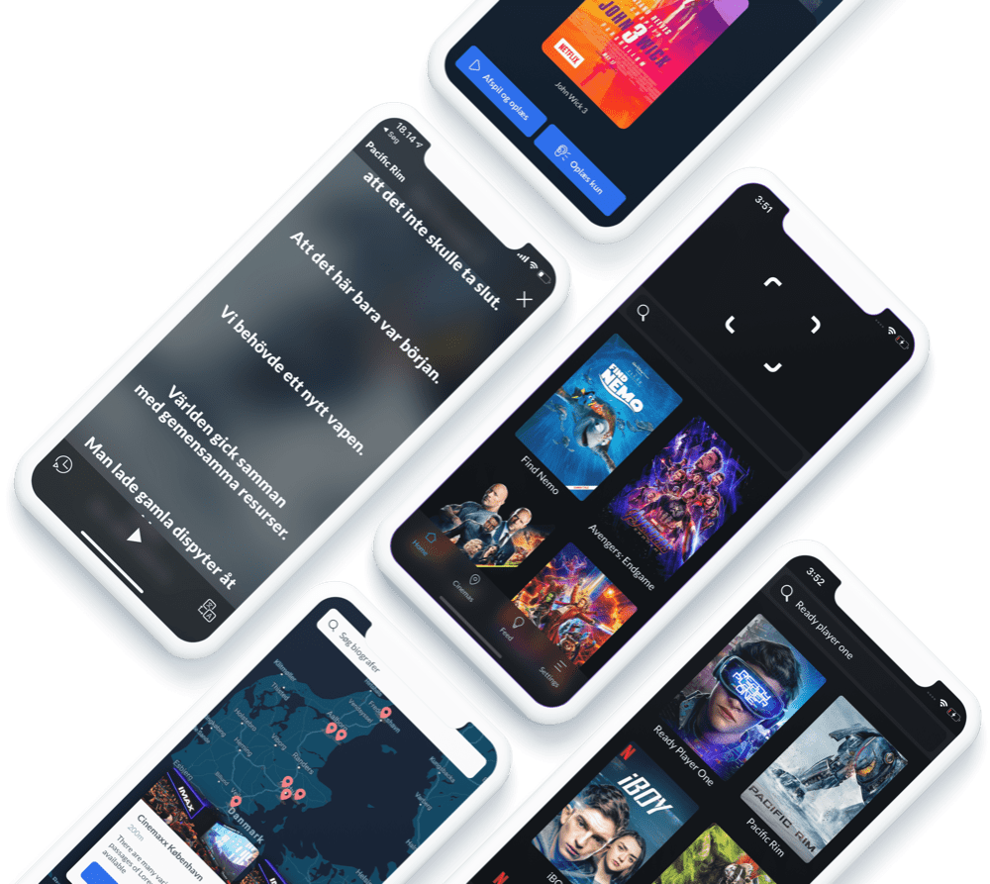
Making movies accessible
BEVICA SCHOLARSHIP PROGRAMME 2023

Slide 2
Agenda
Ideation
MVP
Launch

Slide 4
Ideation
What’s your trigger?
Notes:
Personal Experience
Interest
Experience
What’s your why?

Slide 5
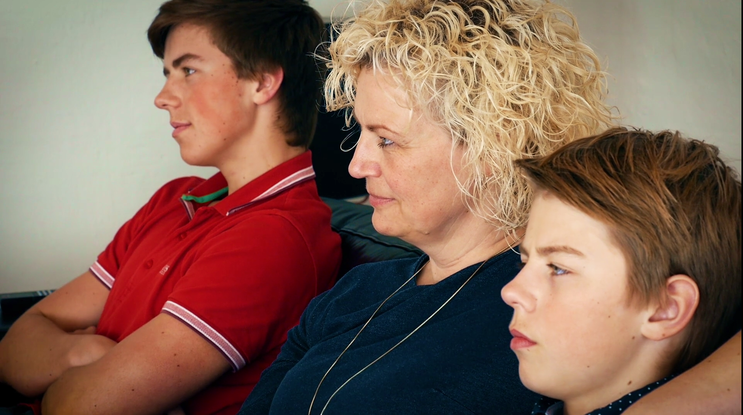

Slide 6
Minimum Viable Product (MVP)
The Double Diamond
Diverge
Converge
Diverge
Converge
Trigger
Are we solving the right problem?
Are we building the right solution?

Slide 7
Are we solving the right problem?
Diverge
Interview (x 100)
Personas
Converge
Hypothesis statements
User stories

Slide 8
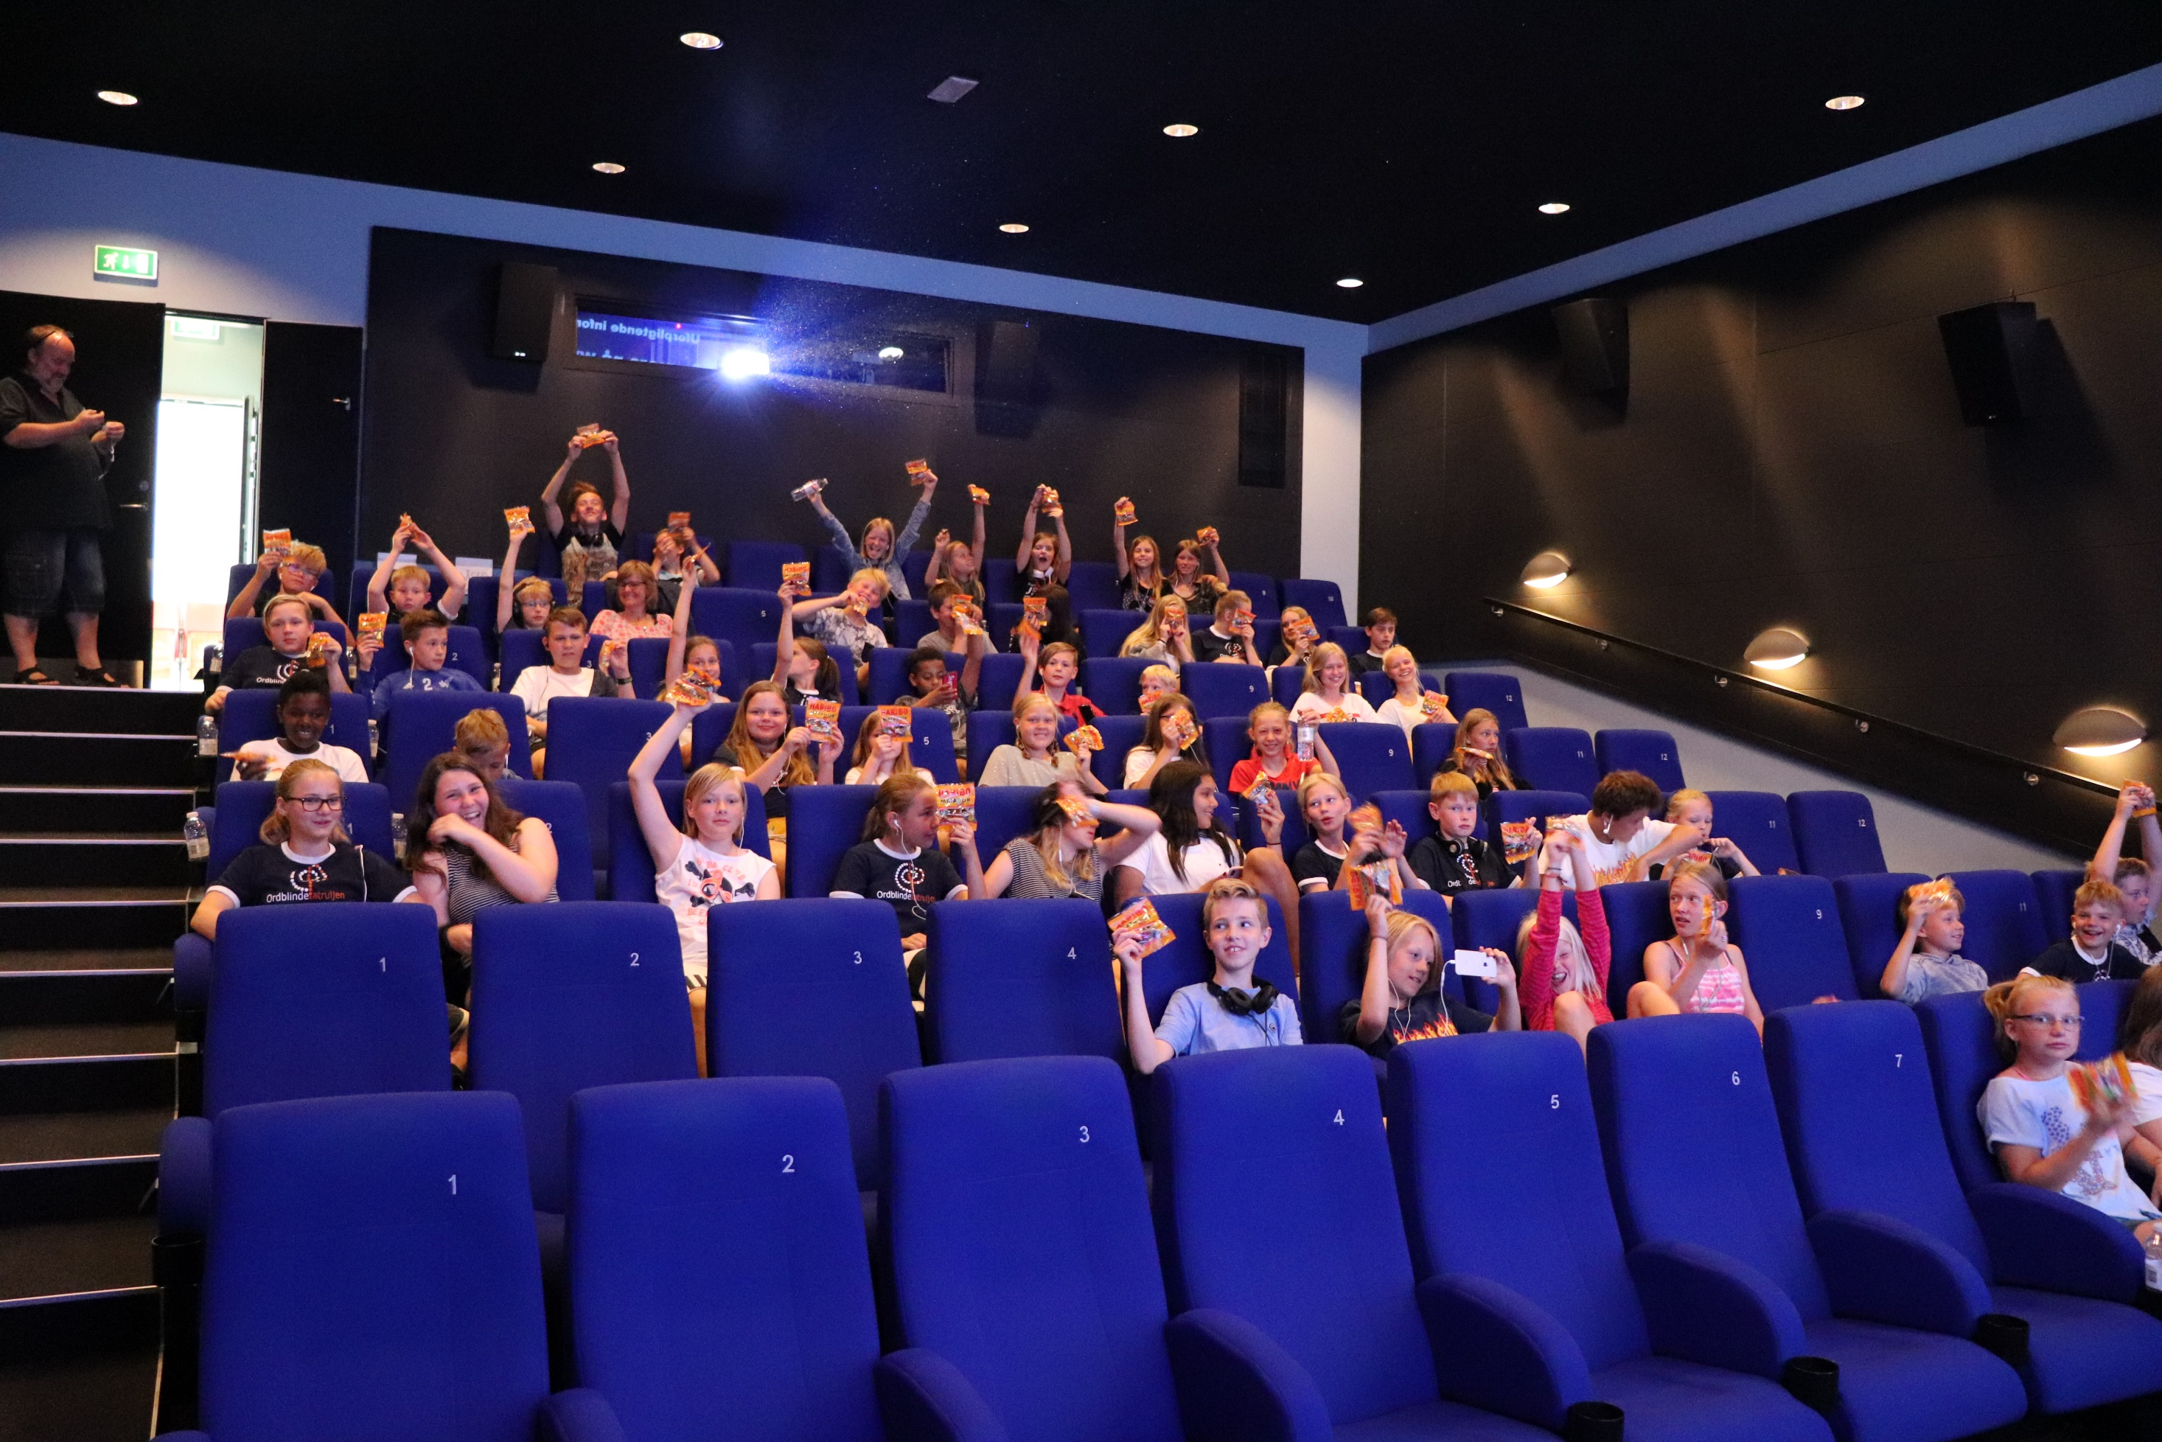

Slide 9
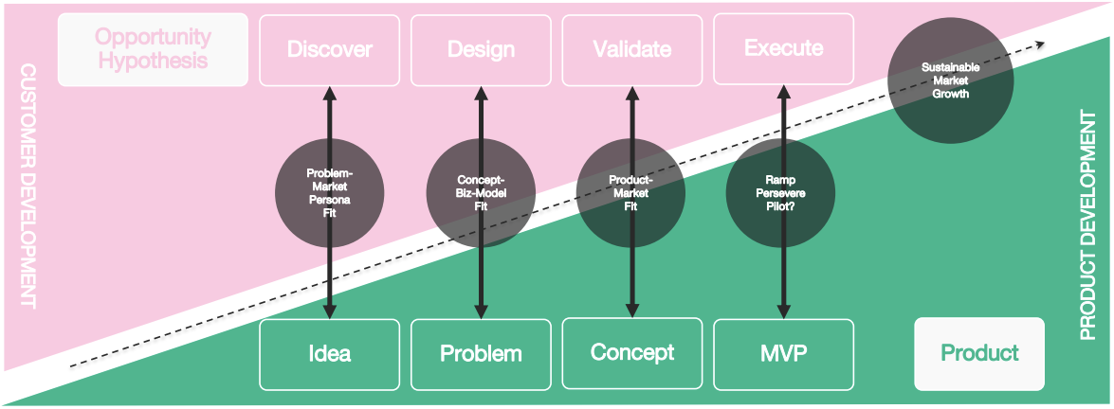
Are we building the right solution?

Slide 10
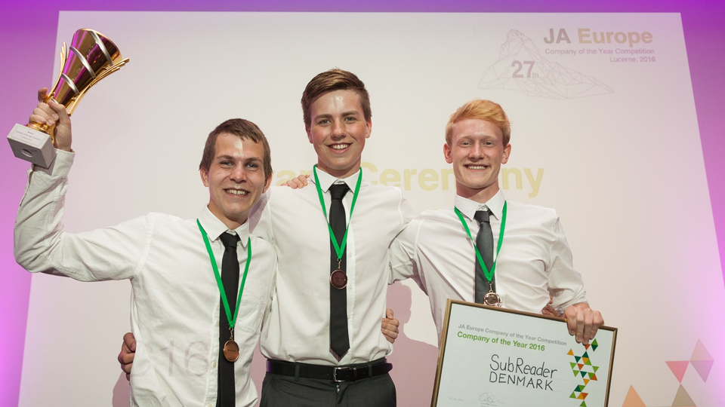

Slide 11
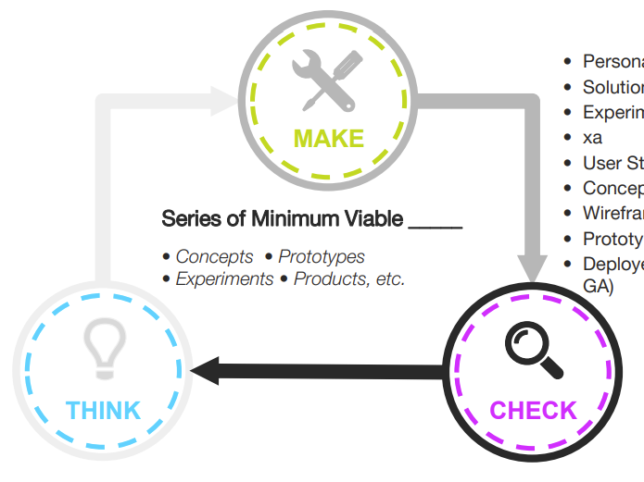
From MVP to Company
Iterate, iterate, and iterate…

Slide 12
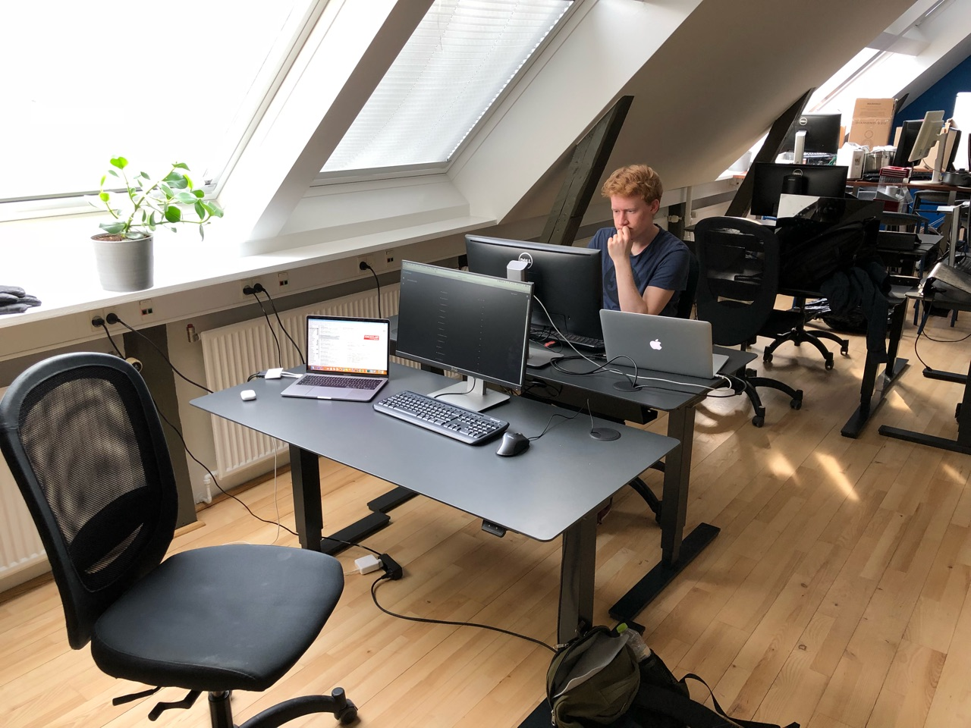

Slide 13
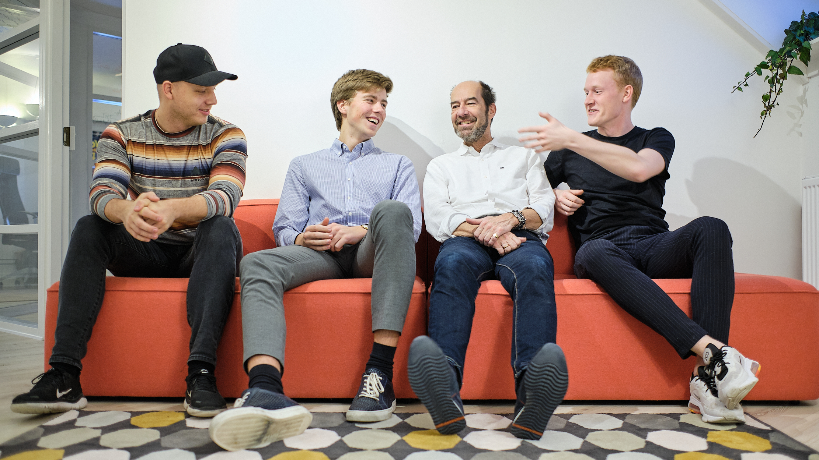

Slide 16
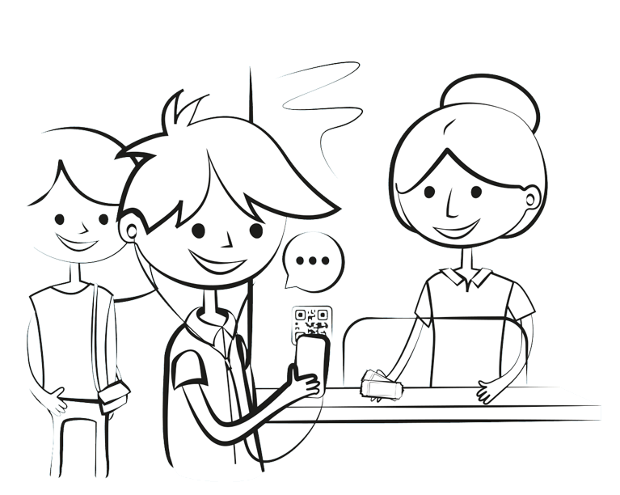
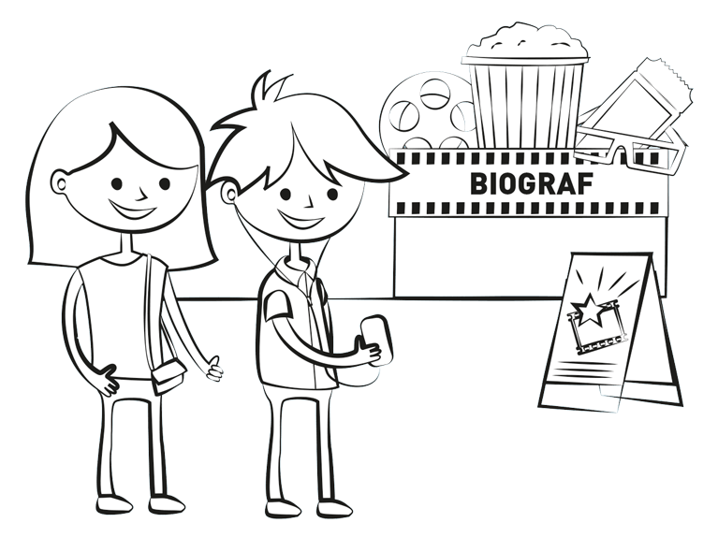
SubReader Cinema
For everyone with reading disabilities
Works with all subtitled movies
Automatic synchronization
25 Cinemas
Free to use in all supported cinemas
1 cinema
75+ Cinemas

Slide 18
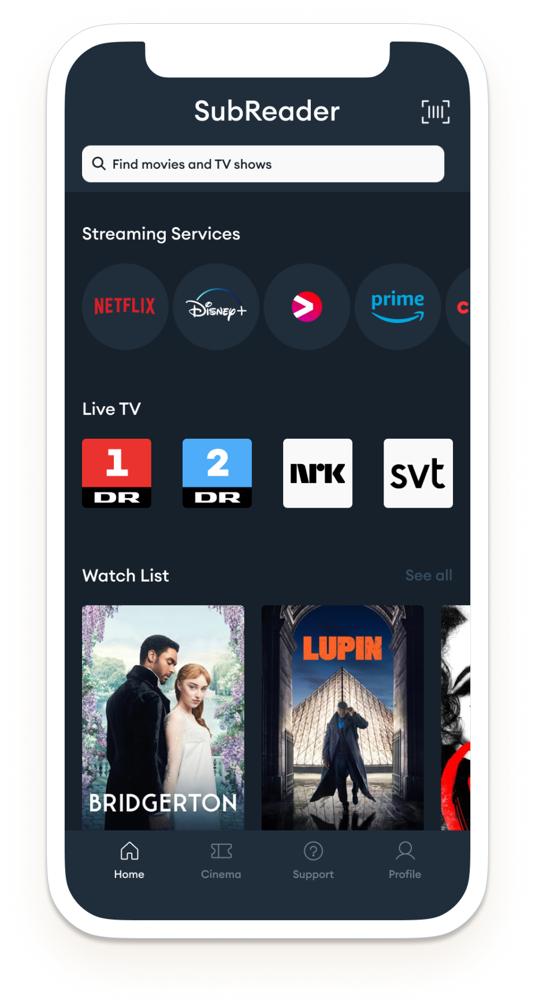
SubReader Plus
Automatic synchronization
AI OCR support for live-TV
Supports the whole library on the services
Offered in
Subscription
49 DKK / mth
Supported services

Slide 20
SubReader School
Assistive tool for slow readers
Simple setup and installation
Log in with UNI-login
SubReader Ambassadors
250+ Ambassadors
70+ Ambassadors
90+ Ambassadors
20

Slide 21
Thank you for listening!
Notes:
+ Spørgsmål

