Slide 1
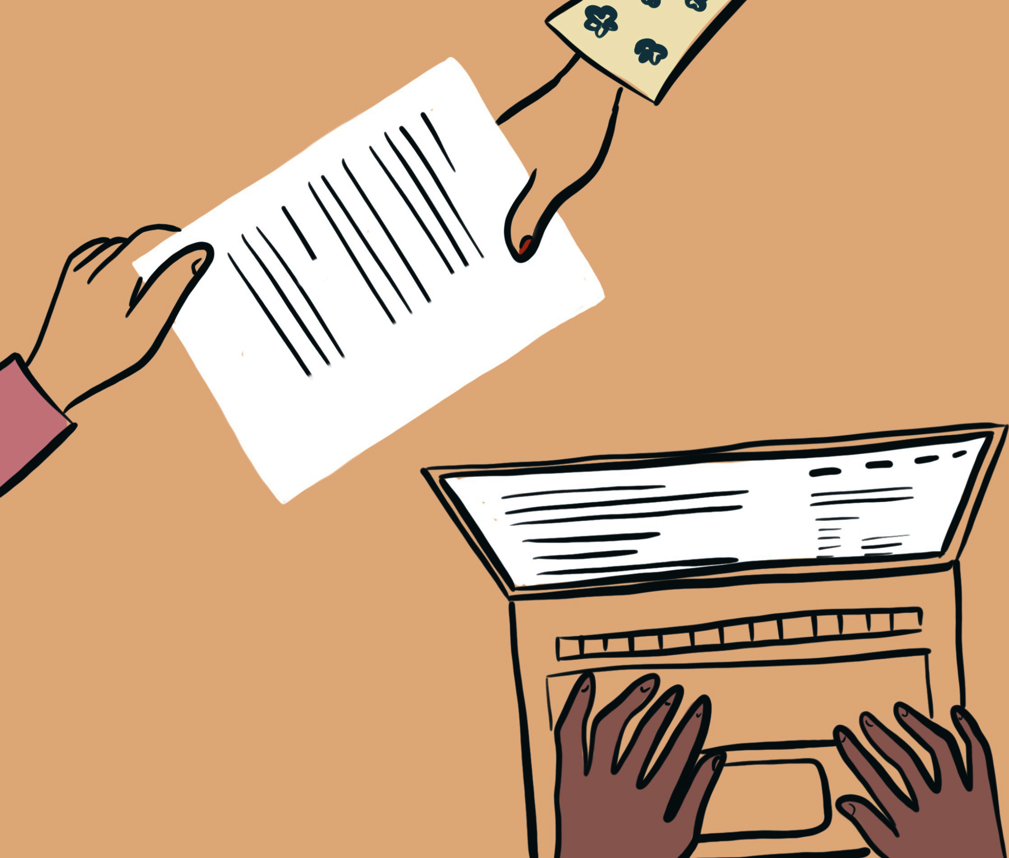
Barbara Nino Carreras
(she/her)
PhD Fellow at the
IT University of Copenhagen

Slide 2
Science and Technology Studies
Anthropology
Human-computer Interaction

Slide 3
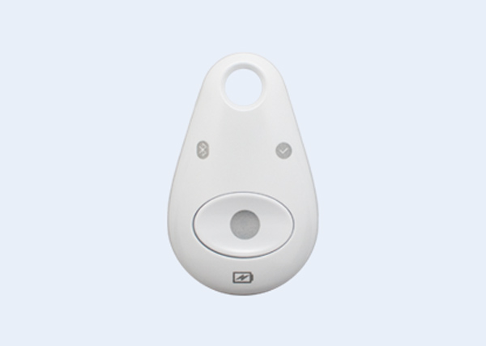
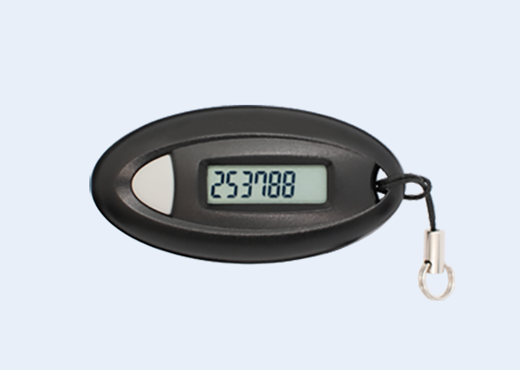
Since the early 2010s, citizens living in Denmark have had to use a digital e-ID to access public and private services
NemID
MitID

Slide 4
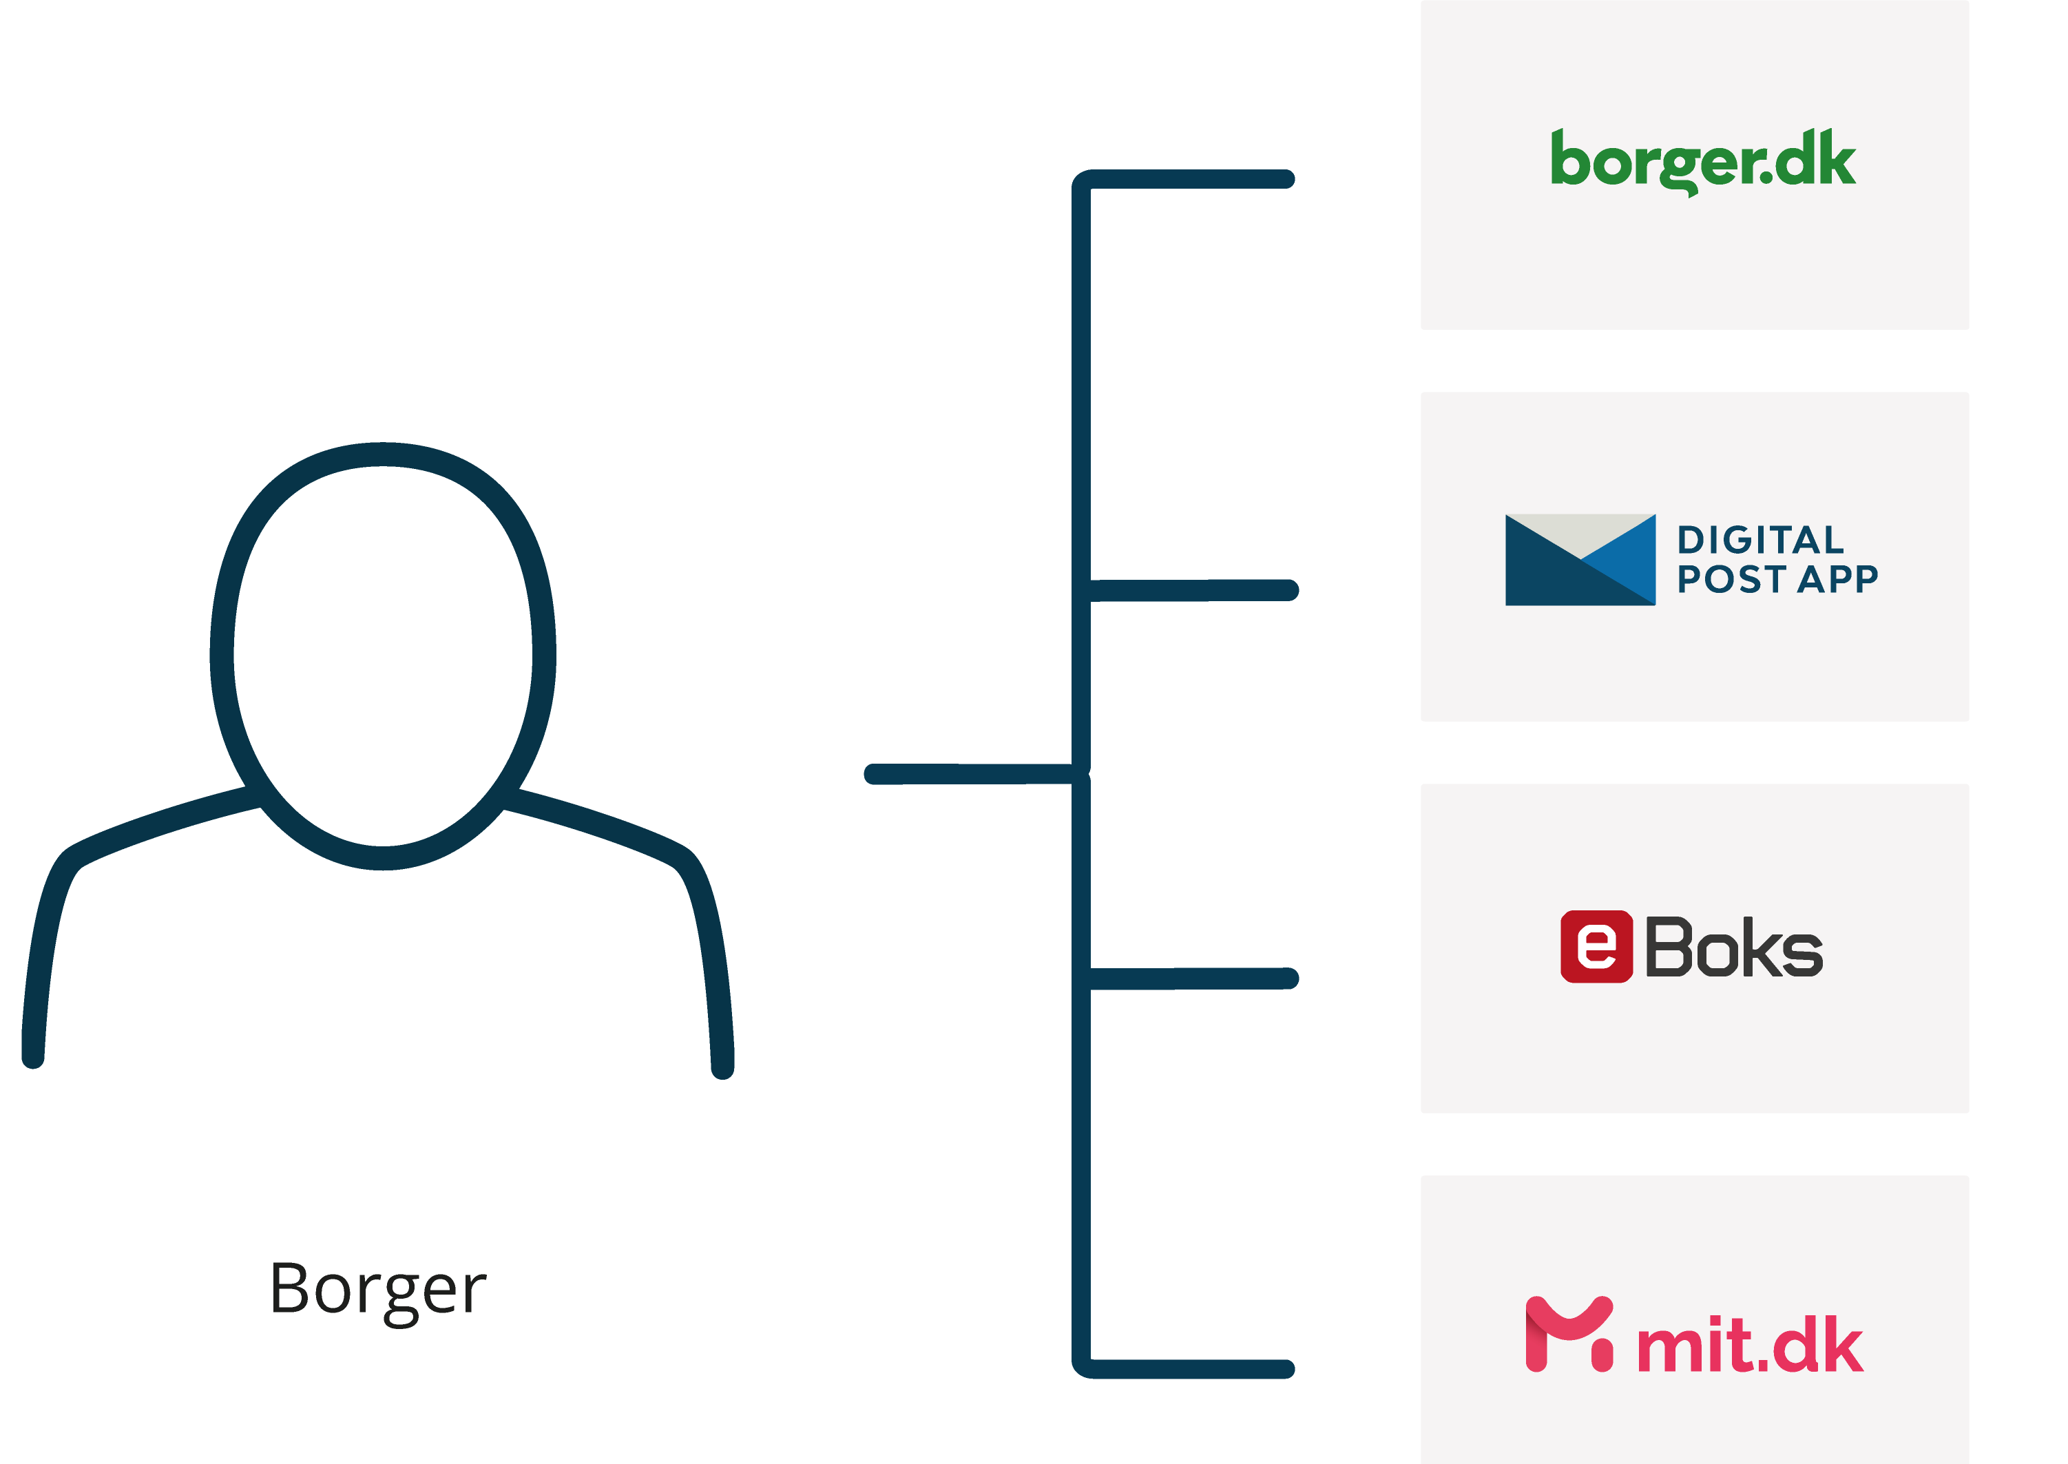
Since the early 2014, citizens living in Denmark have also been mandated to communicate digitally with the authorities. Digital communication with the authorities can be accessed through different mailboxes (public or privately owned). Some citizens can opt-out.

Slide 5
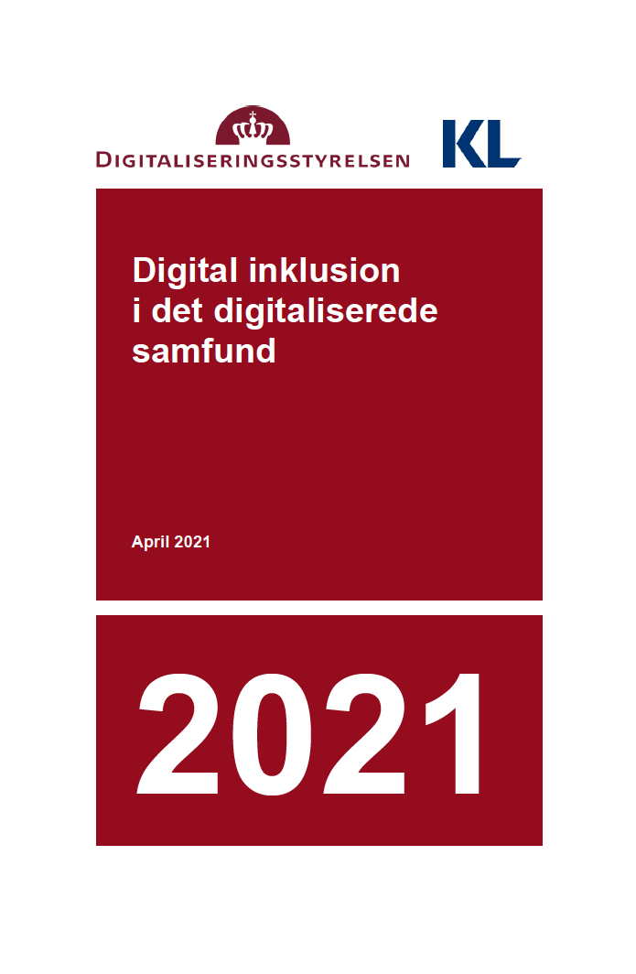
17-22 % of the population or more is challenged by mandatory communication and digital self-service across the public and private sectors

Slide 6
There is an absence of multilingual digital content and interfaces provided by the authorities.
Poor and disabled people encounter barriers to access and use public and private digital self-services.

Slide 7
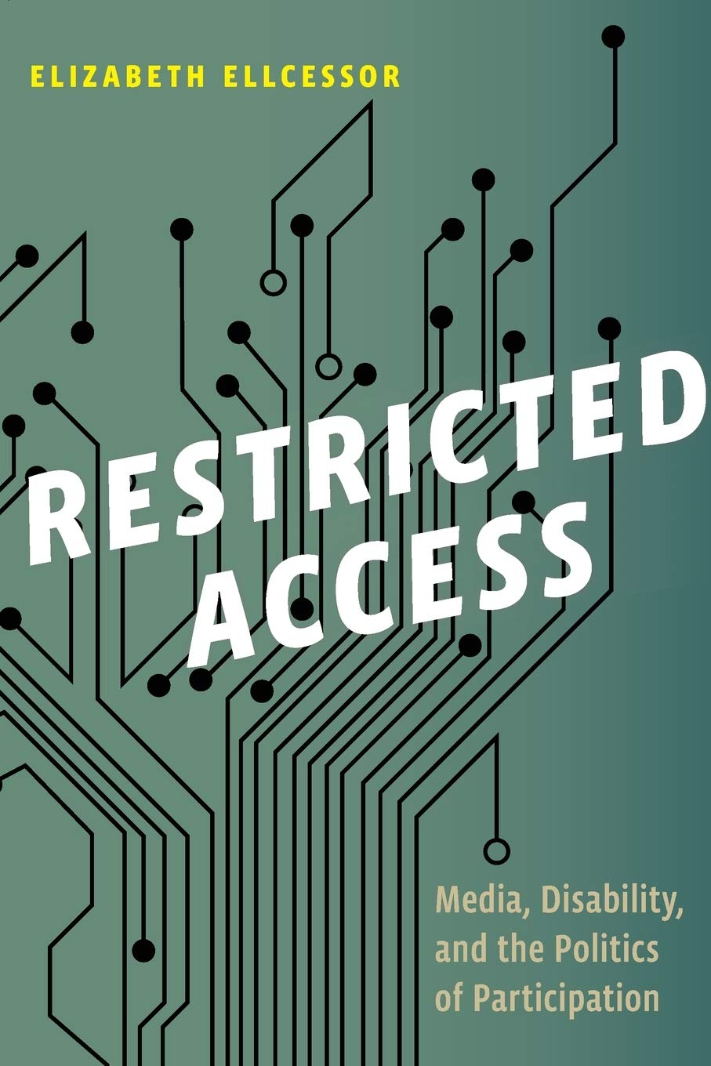
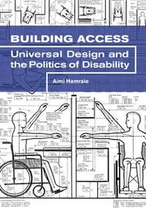

Slide 8
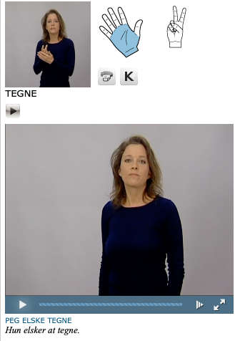
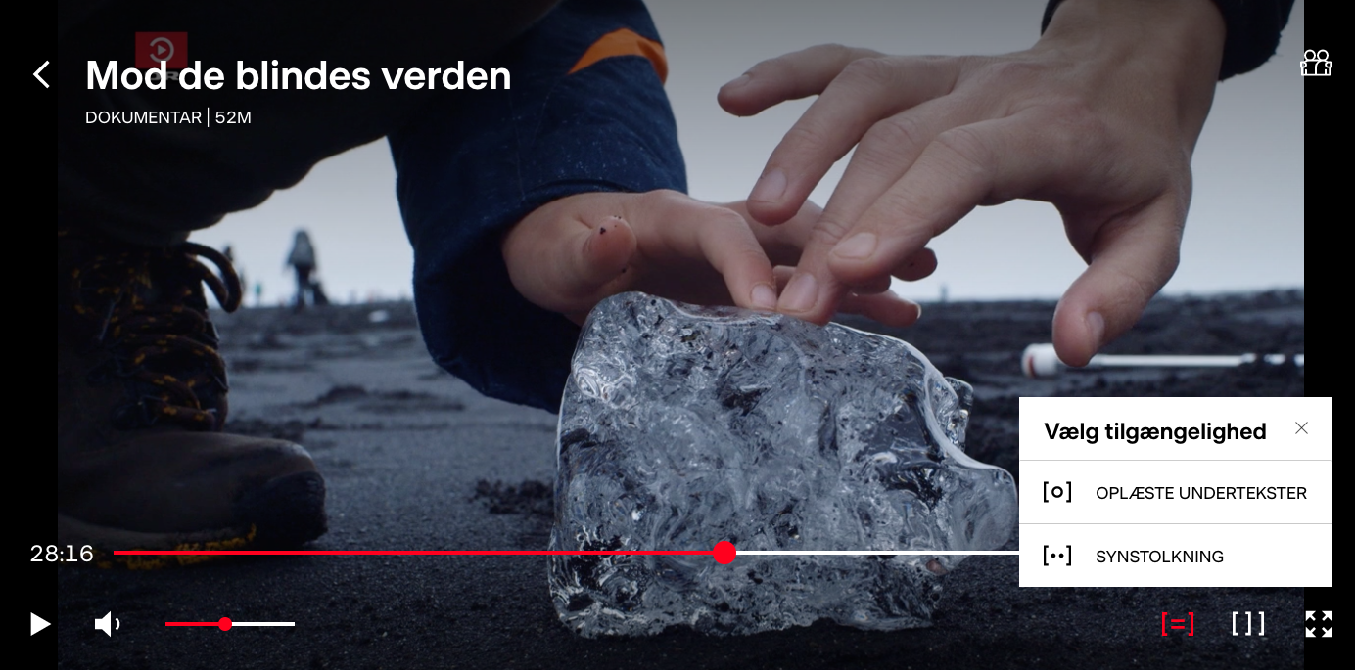
Online dictionary for Danish Sign Language made by the center for sign language and the Danish Deaf Association in 2008
There are many examples of community-lead innovation that we can draw on:
Guideline for disability access in museums and galleries
Easy read PDFs made by and for visual people with learning disabilities by change in the UK
Audio Descriptions
Multimodal storytelling of Christina and Silas on DR
Accessible event planning guidelines by disability justice based performance project & movement led by disabled queers & crips of color.

Slide 9
Thank you!
SOS project
Barbara Nino Carreras
+45 91945517
barb@itu.dk

